Slide 1
Building block-diagonal attention kernel with attention bias
Eric Qu and Yiheng Du

Slide 2
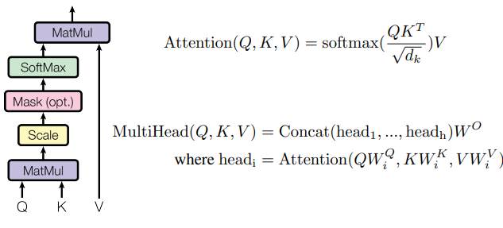
Problem Statement
Attention mechanism drives modern deep learning
Quadratic in sequence length

Slide 3
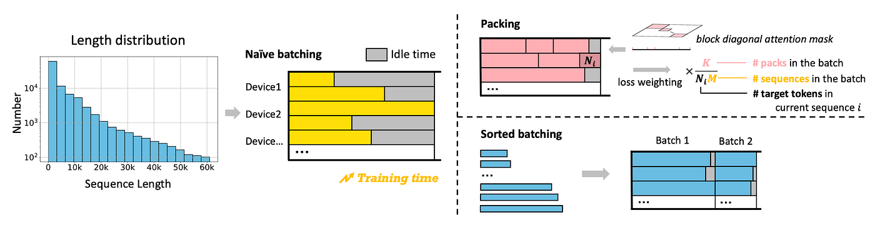
Problem Statement
People use packing to deal with irregular length

Slide 4
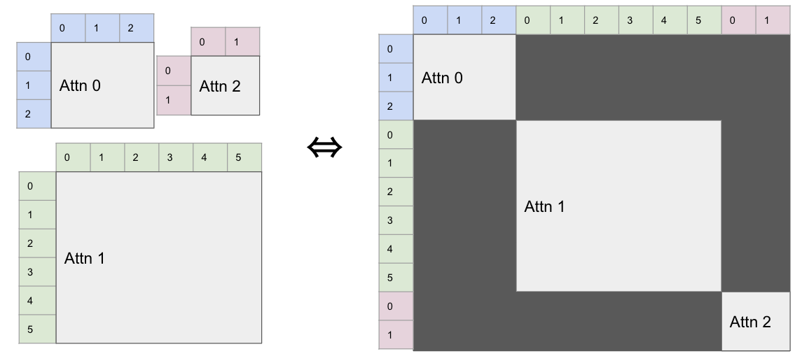
Problem Statement
This motivates the block-diagonal attention in language models

Slide 5
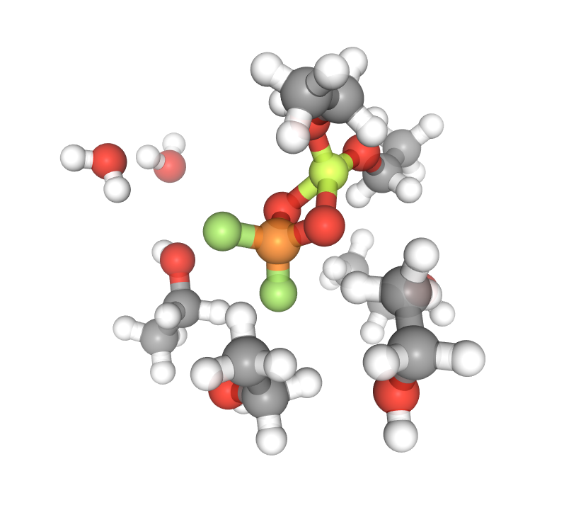
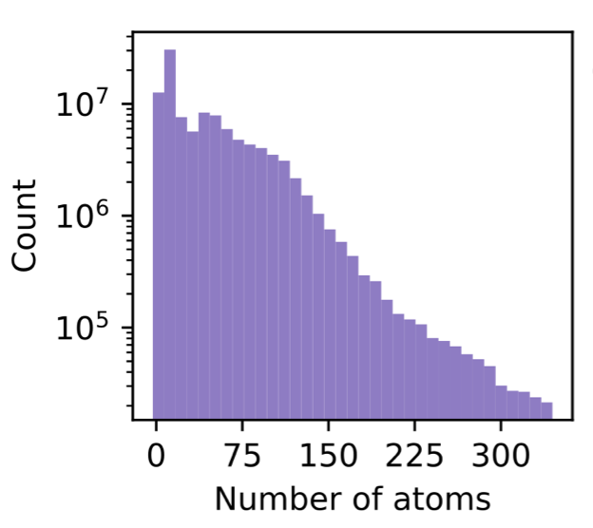
Problem Statement
In the field of AI for Chemical Sciences
State-of-the-art models uses attention across atoms to perform prediction
Molecules on representative datasets differ from each other in the number of atoms
Training a batch of molecules consists of “packing” them together
Current attention kernels are inefficient for block-diagonal attention

Slide 6
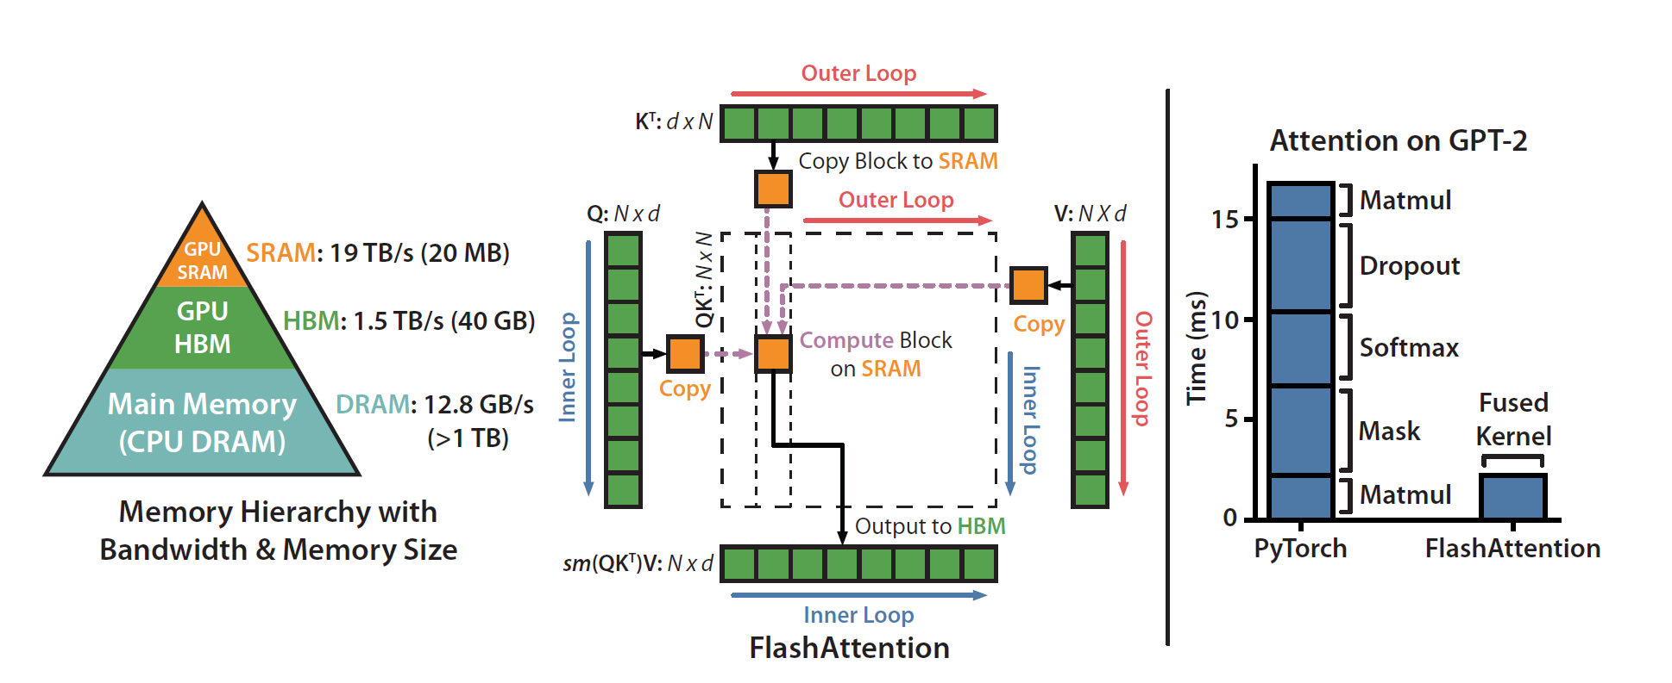
Baseline: Flash Attention
Put tiles of QKT on SRAM for better throughput (never materialize the matrix)
Online Softmax
Works for large matrix

Slide 7
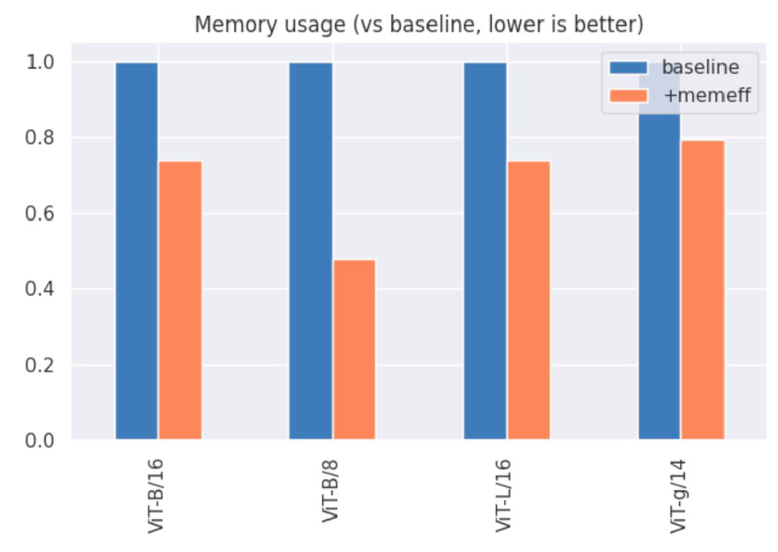

Baseline: xFormers
Includes kernel patterns like block-diagonal
Memory-efficient attention-based implementation
Legacy package, missing support for
a few data types on modern devices

Slide 8
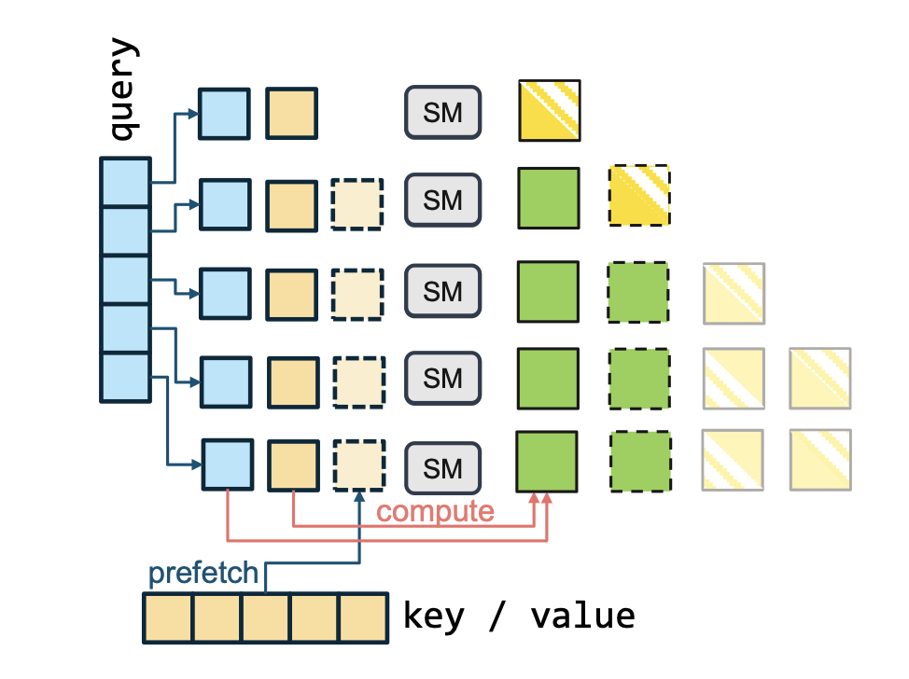
Baseline: Flex Attention
BlockMask Guided Indirect Memory Access
A newer package, still based on flash attention

Slide 9
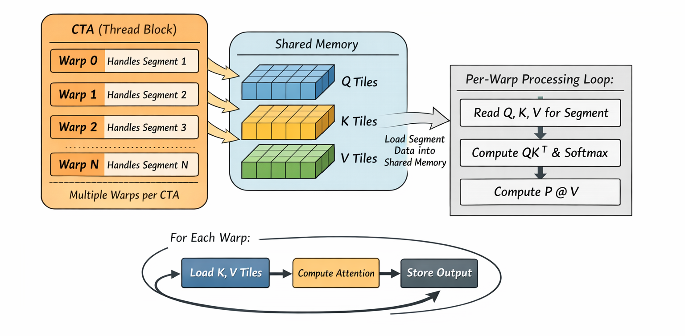
Implementation: Multi-Segment per CTA
Benchmark and profile existing kernels for size vs throughput
Use results to motivate the parallelism based on block size
  What to put on SRAM vs HBM
  Parallel a few small blocks on SRAM

Slide 10
Benchmark and Metric
We will use Nsight to measure:
  Latency per token (µs / token)
  Latency per segment (µs / segment)
  Achieved occupancy / active warps per SM
  Arithmetic intensity / TFLOPs

Slide 11
Thank you!

